Slide 1
Operating System Structures
OS Services
OS Structures

Slide 2

System Calls
Many system calls need parameters to be passed to the OS
Pass parameters in registers
Registers are fewer in number
Place the parameters in a block or table in memory
Place the address of the block in register
Push the parameters onto the stack by the calling program
Popped off by the OS routine

Slide 3
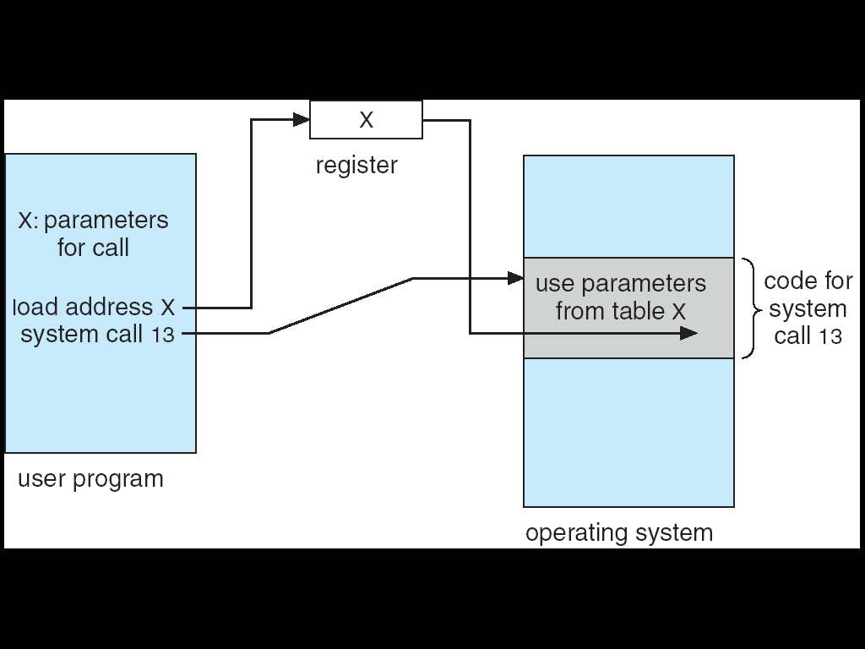
Parameter Passing as a Table
Notes:
3

Slide 4
Types of System Calls
Systems calls are grouped into six categories
Process control
File management
Device management
Information maintenance
Communications
Protection
Process Control
end, abort load, execute
wait event, signal event
allocate and free memory
create process, terminate process
get process attributes, set process attributes
wait for time

Slide 5
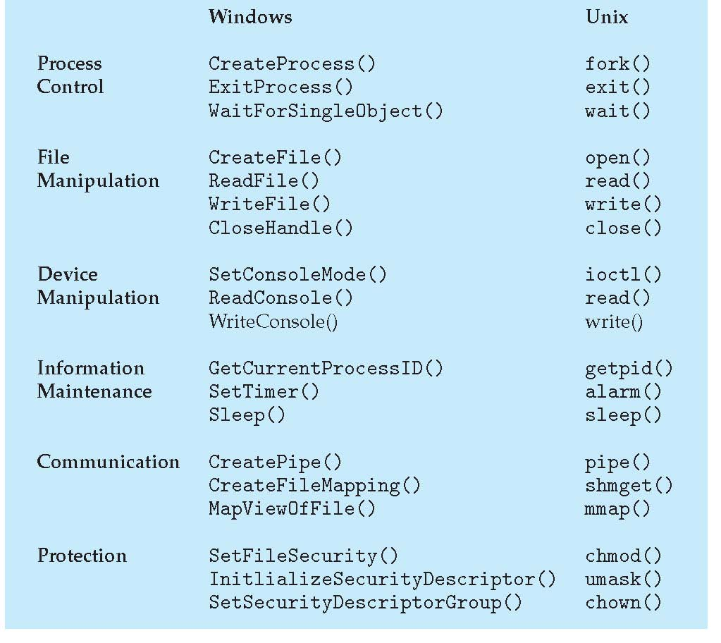
Examples of Windows and Unix System Calls

Slide 6
System Calls for Process Control
end, abort
A running process may need to end normally (end) or abnormally (abort)
Abnormal termination provides the error code
load, execute
A process may want to load another process for execution
Where does control return as the new process terminates?
Depends on whether the existing process is lost, saved or allowed to continue execution concurrently
If the return is to the existing process, memory image of the process should be saved

Slide 7
System Calls for Process Control
create process, terminate process
New processes may be created by an existing process
set process attributes, get process attributes
This provides the ability to control and set the attributes of a new process or to determine the attributes of an existing process
wait for time
Wait for a certain amount of time for a process to terminate
wait event, signal event
Wait for a specific event or the process itself signals completion
Other system calls are available for debugging, getting memory dump, profiling, etc.

Slide 8
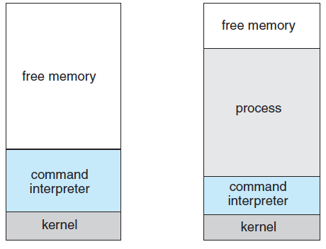
MS-DOS execution
(a) At system startup (b) running a program
Notes:
8

Slide 9
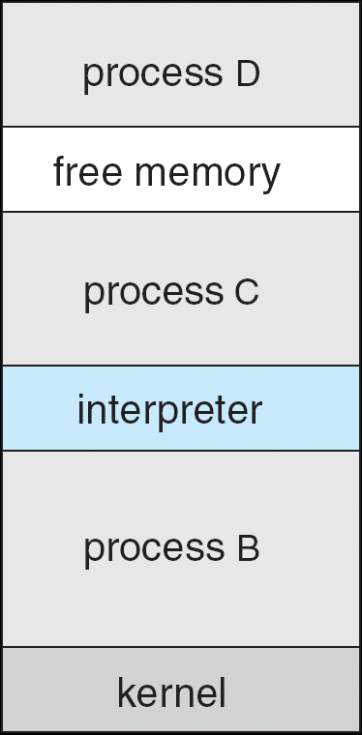
FreeBSD Running Multiple Programs
Notes:
9

Slide 10
File Management System Calls
create file, delete file
Requires the name of the file and its attributes
open, close
After creation, file should be opened for specific operations
read, write, reposition
Operations that can be performed on open file
get file attributes, set file attributes
Get attributes of a file and possibly set them if desired
Attributes are name, type, protection codes, accounting information, etc.
Some systems provide more file management functions and system calls

Slide 11
Device Management System Calls
Resources controlled by the OS are treated as devices
Physical and virtual devices
request device, release device
If there are multiple users of various devices, processes require to request for devices before making use of it and release it after using it
read, write, reposition
Operations that can be performed on the devices that are allocated
Get device attributes, set device attributes
Logically attach or detach devices

Slide 12
Information Maintenance System Calls
System calls that are used only to transfer information between user and OS programs
get time or date, set time or date
get system data, set system data
get process, file or device attributes
set process, file or device attributes
OS maintains information to respond to the calls that are relevant

Slide 13
Communication System Calls
Interprocess communication models
Message-passing model
Processes exchange messages to transfer information directly or indirectly
Shared-memory model
For exchange of information through common, shared memory areas
create, delete communication connection
A connection is established before messages are exchanged between processes
send, receive messages
transfer status information
attach or detach remote devices

Slide 14
System Programs
Provide a convenient environment for program development and execution – system utilities
Varies from simple to complex ones
File management
Manipulates files and directories
Status information
Programs that format and print the output from the status information system calls
Registry may be supported that store and retrieve configuration information
File modification
Several text editors may be available with various options like search or transformations

Slide 15
System Programs
Programming language support
Compilers, assemblers, debuggers and interpreters for common programming languages
Program loading and execution
Used for loading and execution of programs
Communications
Provide mechanism for creating virtual connections among processes, users and computer systems
System utilities or application programs perform other common functions

Slide 16
Operating-System Design and Implementation
Design Goals
Define goals and specifications
Affected by the choice of hardware and the type of system
General purpose or specific
Next level requirements-user and system goals
User goals
System should be convenient to use
It should be reliable, safe and fast
How to achieve these objectives?
System goals
System should be easy to design, implement and maintain - It should be flexible, reliable, error free and efficient

Slide 17
Mechanisms and Policies
An important principle of OS design is to separate policy from mechanism
Mechanisms determine how to do something
Policies determine what will be done
This is important for flexibility
Policies are likely to change over time and place
A general mechanism insensitive to policy changes is desirable
Microkernel-based OS separate mechanisms from policies
Implements basic set of primitive building blocks that are totally policy free
Notes:
Timer is a mechanism for CPU protection– how long should it be set is the policy Priority is given to certain programs is mechanism – which programs should be given priority is policy.

Slide 18
Implementation
All current generation OS is implemented in a high-level language
Easier to write, understand and debug
Portability is achieved
Suffers from reduced speed and increased storage requirements
Performance improvement measures can be used to offset the disadvantage
Bottleneck routines can be identified and replaced with assembly language equivalents
Bottleneck is identified through programs that measure system behavior
Traces can be run to achieve the objectives

Slide 19
Operating System Structure
Design the system by defining small components or modules
Each module is a well-defined portion of the system with carefully defined inputs, outputs and functions
Simple Structure
Many commercial systems do not have well- defined structures
MS-DOS is an example
Interfaces and levels of functionality are not well separated
System is prone to crashes
Original UNIX OS also had limited structuring

Slide 20
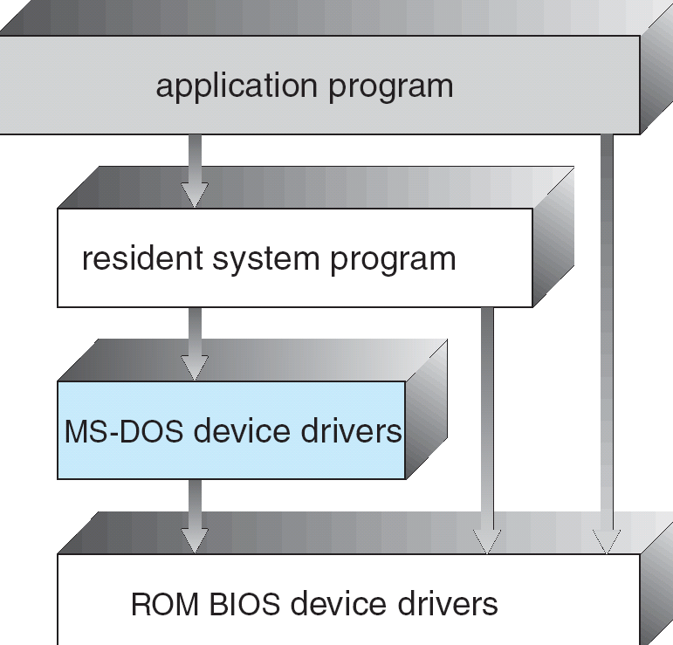
MS-DOS Layered Structure
Notes:
20

Slide 21
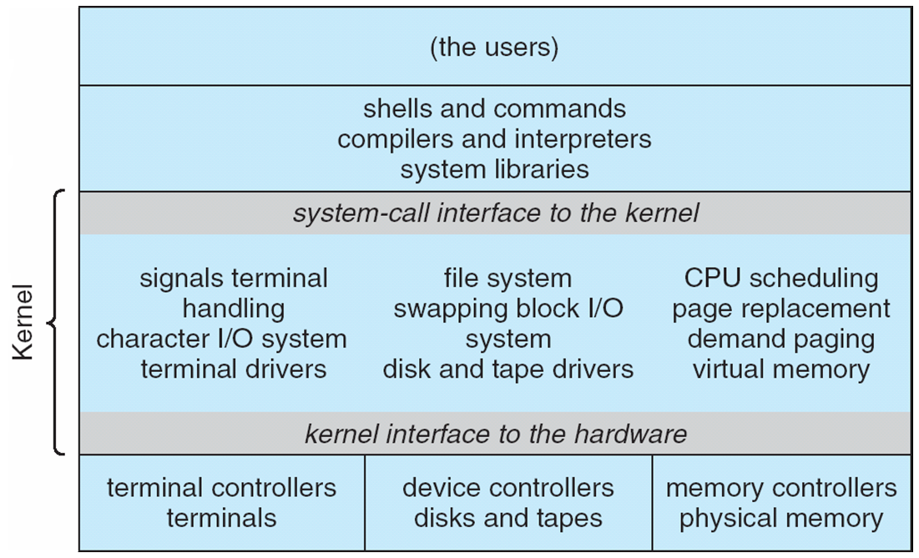
Traditional UNIX System Structure
Notes:
21

Slide 22
Layered Approach
Proper hardware support allows OS to be partitioned into smaller modules
A top-down approach can be taken to design the modular system
Modular system can be designed using a number of approaches
Layered approach
OS is broken into a number of layers or levels
Bottom layer is the hardware and the highest layer is the user interface
An OS layer is an implementation of an abstract object made up of data and the operations that can manipulate data
Layer M consists of data structures and a set of routines that the higher-level layers can invoke

Slide 23
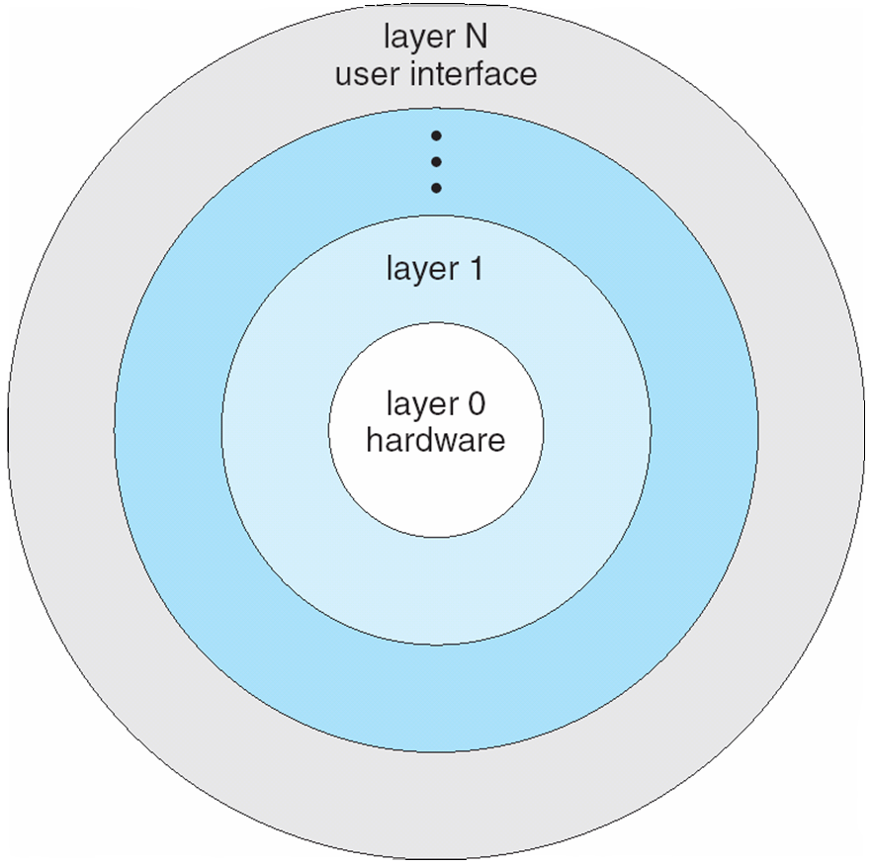
Layered Operating System
Notes:
23

Slide 24
Layered Approach
Advantages of layered approach
Simplicity of construction and debugging
Simplifies system verification
Problems with layered approach
How to appropriately define the layers
Some layers may not be completely self- contained violating the basic principle of layered approach
Less efficient in terms of performance
Recent developments
Fewer layers with more functionality have been designed to overcome the above problems

Slide 25
Microkernels
This method structures the kernel by removing all nonessential components and implements them as system and user-level programs
Results in smaller kernel
Microkernel provides minimal process and memory management and some communication facility
Communication is through message passing
Benefits of microkernel approach
Ease of extending the OS
Easier to port
It provides more security and reliability
Examples are Tru64 UNIX and QNX
This approach suffers from performance losses

Slide 26
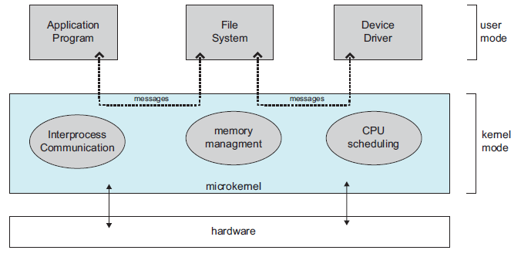
Architecture of a Typical Microkernel

Slide 27
Modules
Current methodology is to use loadable kernel modules
Kernel has a set of core components
Links dynamically with additional services during boot time or during run time
Implementations of UNIX using this methodology
Solaris, Mac OS X, etc.
Solaris
A core kernel with seven types of loadable modules
Reading assignment

